Slide 1
RETURN OF THE GDP

Slide 2
Understanding the the Global Economy is rough. It doesn’t have to be.
Data Source: WorldBank www.worldbank.org
Dataset: World Indicators (over 1300+)
Goals:
Use visualization + select indictors to show the global economy
The US tech sector and economy has changed drastically over the last 15 years, what about the rest of the world?
Beta Plots:
https://plot.ly/~tdlee/157/time-required-to-start-a-business-days/
https://plot.ly/~tdlee/156/
https://plot.ly/~tdlee/154/

Slide 3
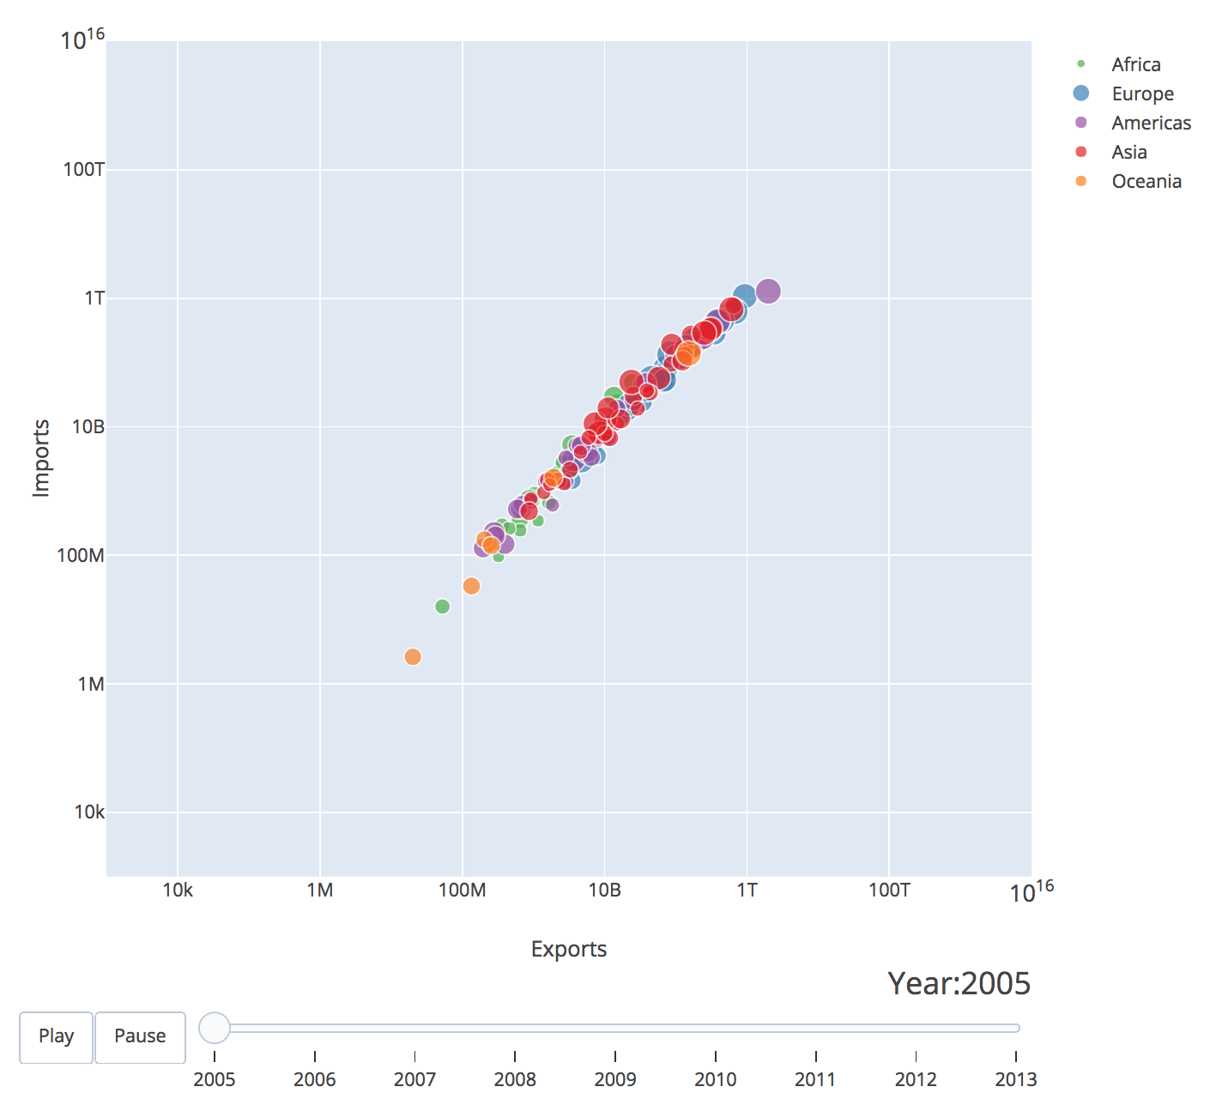
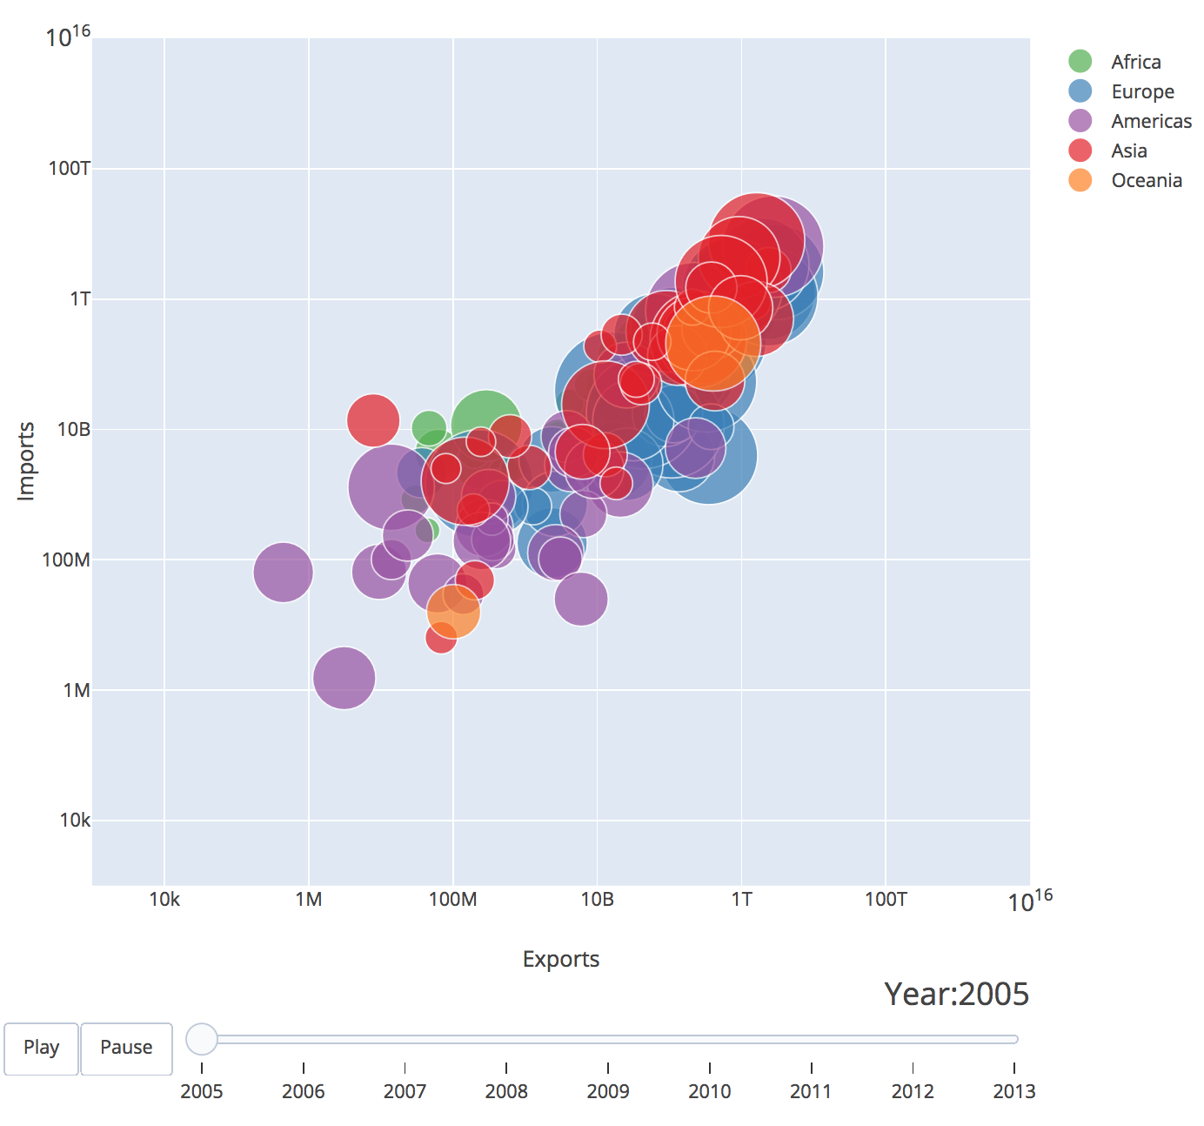
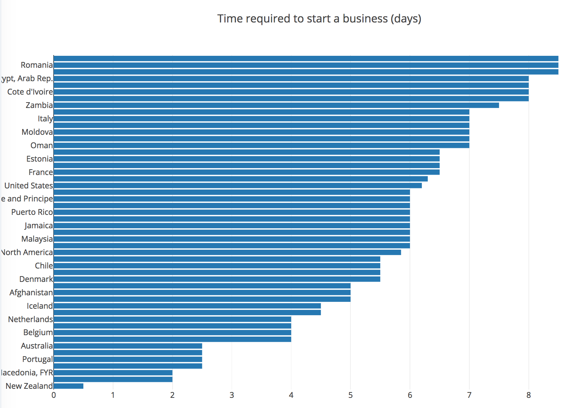
Beta!

